Slide 1
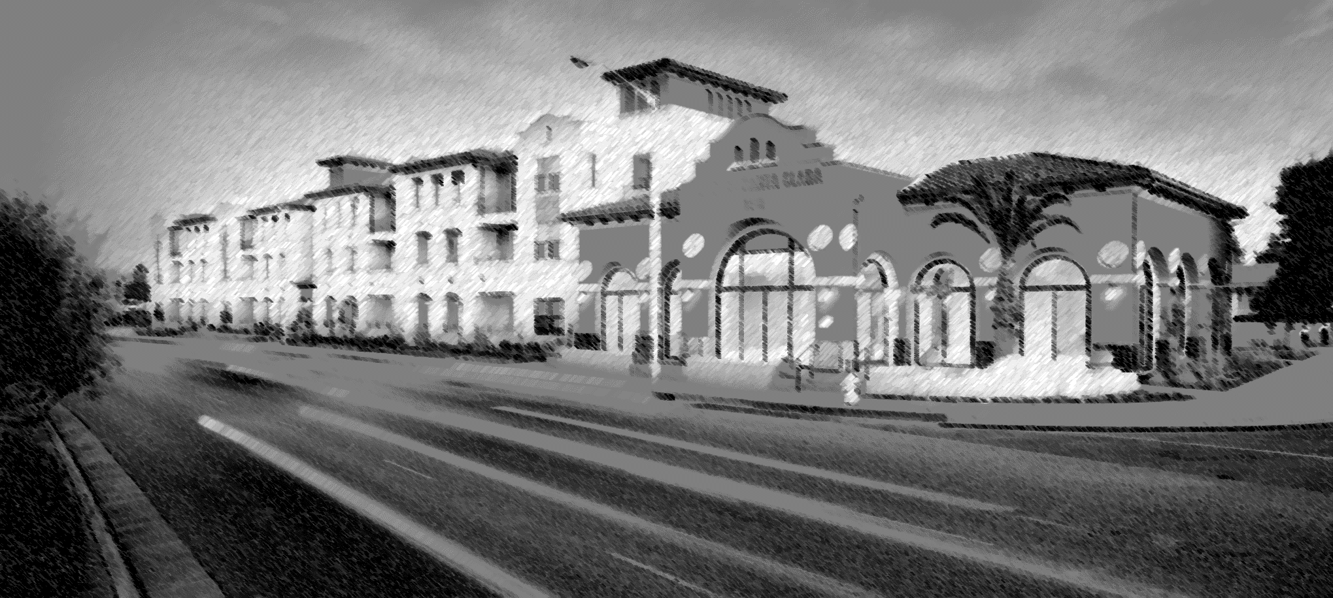
Environmental Impact Report Scoping Meeting
El Camino Real Specific Plan
El Camino Real Specific Plan

Slide 2
Agenda
Introductions and Welcome
Explanation of the proposed project
Overview of the Environmental Impact Report (EIR) process
Preliminary scope of the EIR
Public input on the scope of the EIR
Adjournment
El Camino Real Specific Plan

Slide 3
Introduction and Welcome
Meeting Purpose
To provide information on the EIR process
To give you a brief overview of the project
To get your input on the scope of the EIR
Topics to be analyzed in the EIR
Alternatives to be analyzed in the EIR
El Camino Real Specific Plan

Slide 4
Proposed Project
Project Area
3.2 mile corridor from the western City Limits to Lafayette Street.
Approximately 316 acres of properties that are located immediately adjacent to the segment of the El Camino Real within the Specific Plan boundary.
El Camino Real Specific Plan

Slide 5
Proposed Project
Existing Conditions
El Camino Real is currently an automobile-oriented corridor comprised of a mix of commercial strip malls and newer residential development.
The City’s General Plan envisions the El Camino Real as a tree-lined, pedestrian and transit-oriented corridor with a mix of residential and retail.
El Camino Real Specific Plan

Slide 6
Proposed Project
Purpose of the El Camino Real Specific Plan
Refine and implement the General Plan vision for the area.
Create goals, policies, and design standards.
Identify specific improvements and actions to achieve the vision
Address required specific plan topics such as land use, transportation, and infrastructure.
El Camino Real Specific Plan

Slide 7
Proposed Project
Draft Land Use Plan
El Camino Real Specific Plan

Slide 8
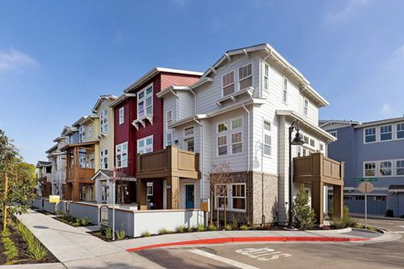
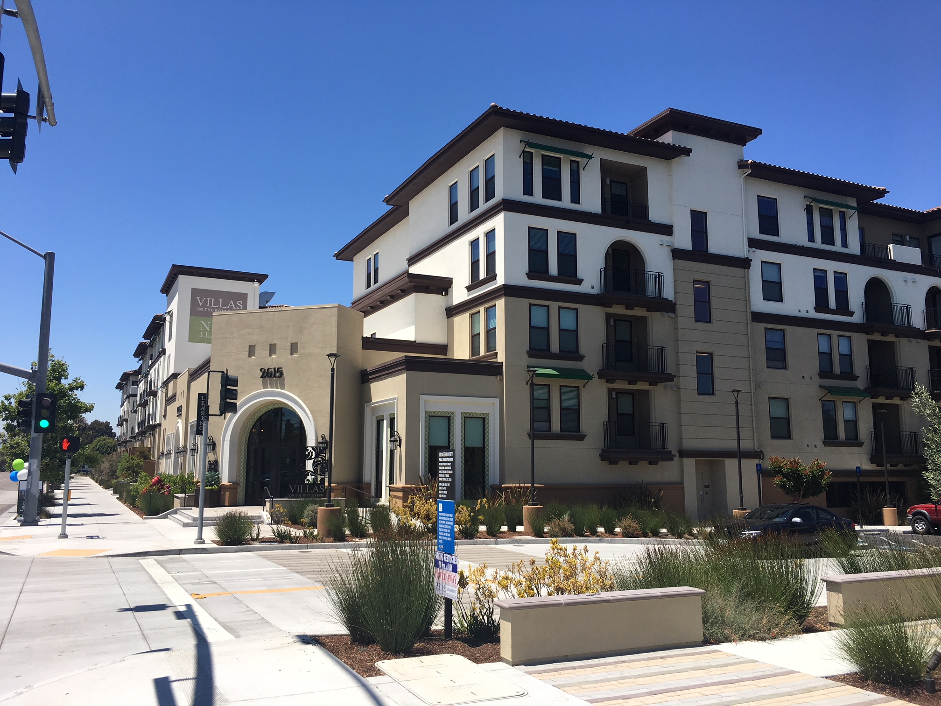
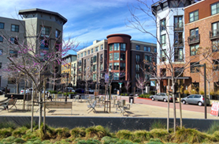
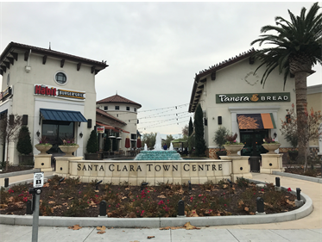
Proposed Project
Draft Land Use Plan – Growth Assumptions
An additional 6,200 residential units beyond the 2,073 that are allocated under the General Plan and of which some have been constructed in the project area.
Approximately 315,000 square feet less commercial space than currently exists in the project area.
El Camino Real Specific Plan

Slide 9
Proposed Project
El Camino Real Right-of-Way Alternative
The project includes recommendations for conceptual modifications to the roadway and streetscape enhancements to enable safer and a greater number of multi-modal transportation options along El Camino Real.
El Camino Real Specific Plan

Slide 10
CEQA
What is an Environmental Impact Report (EIR)?
An informational document designed to inform the public and decision makers about potential environmental impacts of a project
A problem-solving tool to avoid or less project impacts:
Mitigation measures
Alternatives
Environmental impacts are just one of the factors decision makers consider
El Camino Real Specific Plan

Slide 11
CEQA
Key Component of the EIR
Executive Summary
Project Description
Environmental Impact Analysis
Existing Environmental Setting
Thresholds of Significance
Project Impacts
Cumulative Impacts
Mitigation Measures
Significance After Mitigation
Alternatives
El Camino Real Specific Plan

Slide 12
CEQA
Preliminary Scope of the EIR
The EIR will be a program level document that analyzes the broad environmental effects of the project.
The analysis will focus on the issues present in the project area and potentially impacted, including:
El Camino Real Specific Plan

Slide 13
CEQA
Solicit input on content of Draft EIR
Distribute Notice of Preparation
The EIR Process
Prepare Draft EIR
File Notice of Completion & post Notice of Availability of Draft EIR
WE ARE HERE
Public review (45-day minimum)
Solicit comments on adequacy of Draft EIR
EIR Process
Prepare Final EIR, including response to comments on Draft EIR
Prepare findings and, if applicable, Statement of Overriding Considerations
Lead agency certifies EIR, makes decision on project; file Notice of Determination
El Camino Real Specific Plan

Slide 14
Next Steps
Helping us with the scope of the EIR.
Overall project timeline.
El Camino Real Specific Plan

Slide 15
Helping us with the EIR Scope
Provide your comments on the scope of the EIR
Environmental topics to be addressed
Alternatives to be evaluated
Please provide your comments by 5:00 PM on June 6, 2019
Comments can be emailed to Lxavier@SantaClaraCA.gov, or mailed to:
City of Santa Clara – Community Development Dept.
Attn: Lesley Xavier, Principal Planner
1500 Warburton Avenue
Santa Clara, California 95050
El Camino Real Specific Plan

Slide 16
El Camino Real Specific Plan
Project Timeline
Notes:
The next step in the planning process is to prepare the environmental analysis as required by the California Environmental Quality Act (CEQA).
This analysis will be conducted on using the preferred land use plan and a preferred El Camino Real right-of way design.

