Slide 1
City of Santa Clara Independent Redistricting Commission (IRC)
Public Hearing #3
December 9, 2021
Shelley Lapkoff, Ph.D. & Jeanne Gobalet, Ph.D. LAPKOFF & GOBALET DEMOGRAPHIC RESEARCH, INC. www.demographers.com Oakland and Saratoga, California

Slide 2
Agenda for this presentation
Brief overview of:
Reason for redistricting Legal requirements
(that demographers follow)
Communities of interest
Pieces Kit and Maptitude Online Redistricting (MORe) map-drawing tools
Demonstration of MORe

Slide 3
What is Redistricting?
Every 10 years, cities must redistrict (adjust Council District boundaries to equalize total populations) using the new Census counts
Federal and state laws apply
Cities must adopt new boundaries before
April 17, 2022
The new council districts will be used until Census 2030 data are released
Incumbents will complete their terms of office even if they no longer live in the district they were elected to represent

Slide 4
Legal guidelines that demographers follow:
Federal Law & Supreme Court Decisions:
        Population equality
        Voting Rights Act
        No Racial Gerrymandering
California Fair Maps Act (AB 849, 2019), as amended by
AB 1276 (2020):
        Redistricting criteria
        Public outreach
        Charter Cities: Elections Code §§ 21620 et seq.

Slide 5
Current Council Districts - Official 2020 Redistricting Population Data

Slide 6
Federal Voting Rights Act (VRA)
Federal Voting Rights Act prohibits:
        Districts that have a racially discriminatory effect
        Districts that came about because of discriminatory intent
Section 2: no local government's redistricting map can deny or abridge the right to vote on account of race, color, or membership in a language minority group.

Slide 7
California’s FAIR MAPS Act (AB 849, 2019) applies to cities and counties. It requires that cities:
Encourage residents to participate in the redistricting process by
        Maintaining a redistricting website for 10 years
        Providing translation services upon request
        Offering multiple ways for the public to provide testimony and feedback (in writing and electronically)
        Public access to demographic/mapping data and software

Slide 8
California’s FAIR MAPS Act (AB 849, 2019) - continued
The law requires that cities:
Hold at least 4 public hearings, with specific protocols
    At least one meeting held before the IRC and demographers begin to draft maps
    At least one meeting after 6 pm or on a weekend
    Meetings have definite start times
    5 day’s notice for public hearings; Adopted plan must be published and available 7 days prior to adoption;

Slide 9
FAIR MAPS Act criteria, in order of priority, that should/should not be used during plan drawing.
Federal Law (population equality, Voting Rights Act)
Geographical contiguity
Geographic integrity of communities of interest (especially do not split communities of protected groups)
Geographic integrity of cities and unincorporated communities
Easily identifiable and understood boundaries
Geographic compactness
No political party considerations (including incumbency and candidacy)

Slide 10
Communities of Interest (COIs) - Examples
A “community of interest” is a population that shares common social or economic interests that should be included within a single city council district for purposes of its effective and fair representation. Communities of interest do not include relationships with political parties, incumbents, or political candidates. -AB 1276
Recognized neighborhoods
Areas with similar living standards, including similar
income and educational levels, similar race/ethnicities

Slide 11
Current Council Districts
With Nextdoor Neighborhoods
shaded – possible communities of interest

Slide 12

We must comply with the laws, but there are tradeoffs:
Redistricting criteria can rarely (if ever) be optimized simultaneously.
Demographers identify tradeoffs when comparing scenarios and give impartial evaluations.
IRC will need to understand tradeoffs & explain them to the public

Slide 13
Timeline

Slide 14
What is Your Community of Interest?

Slide 15
Appendix

Slide 16
Definitions
Redistricting | Adjusting election district boundaries to equalize total populations. Required after each new U.S. Census.
Community of interest | Geographical area where people share common social and economic interests and should be in a single District or be considered when drawing boundaries.
Advisory Redistricting Commission (ARC) | Appointed group that will recommend a plan to the Board of Supervisors (3 members per Sup. District) in late November
Population equality | Districts need to have (almost) equal Census 2020 populations
Voting Rights Act | Federal law that protects minority voting rights
Gerrymander | To design odd-shaped election districts to achieve a purpose like reducing minority voting power or increasing a political party’s representation
Deviation/plan deviation | A measure of how equal the Districts’ total populations are
Redistricting criteria | Legally required things to consider when drawing boundaries

Slide 17
Extra slides

Slide 18
Agenda for demographers’ presentation
What is redistricting?
Why redistrict?
Current Council Districts
Legal requirements
(that demographers follow)
Communities of interest
Timeline

Slide 19
History of Santa Clara’s Council Districts
The current plan was developed by the Santa Clara Ad-Hoc Advisory Districting Committee in 2018
The Commission listened to public testimony, deliberated, and drafted plans. It followed both legal requirements and best practices.
Later that year, the court ordered that this plan be used for the 2018 election.

Slide 20
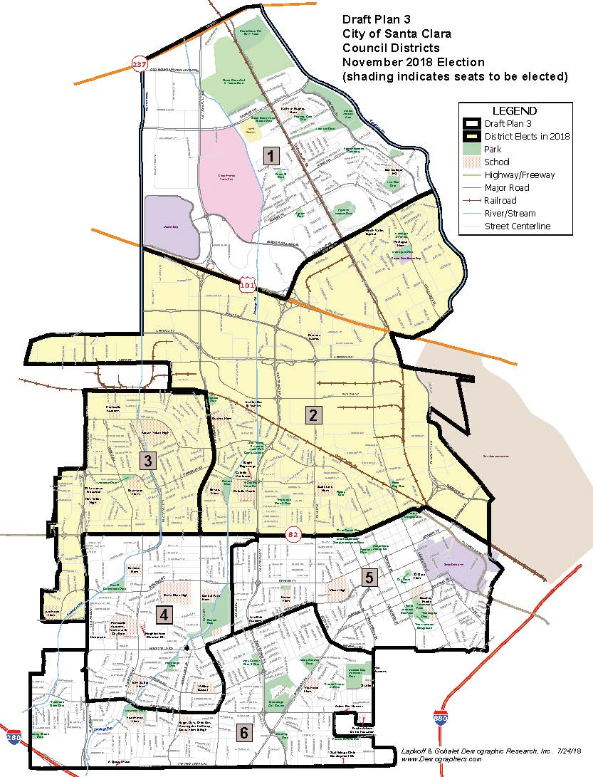
Current Council Districts
20

Slide 21
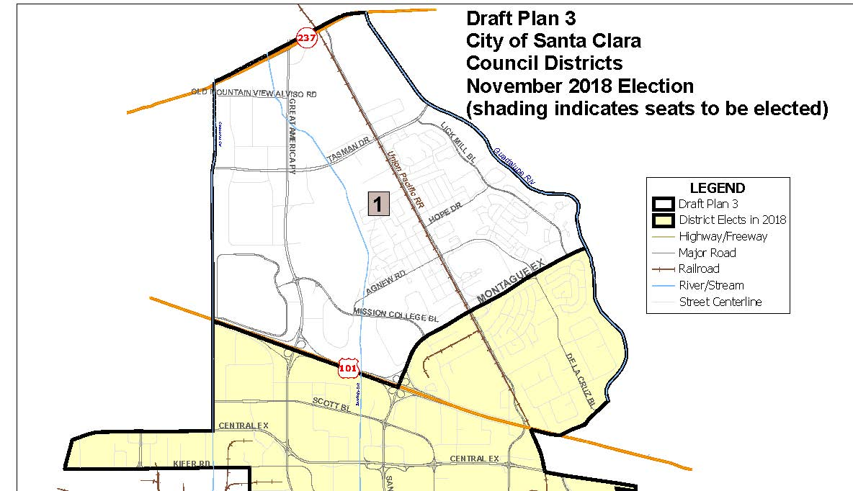
Northern Detail: Current Council District Boundaries

Slide 22
Southern Detail: Current Council District Boundaries

Slide 23
Draft Plan 3 data (became the 2018 court-ordered plan) using 2010 Census Data - Plan deviation was = 8.8%

Slide 25
Our Qualifications
We have provided districting and redistricting services since 1990
We have helped redistrict dozens of California jurisdictions
We helped Santa Clara transition from at-large to by-district elections
We have PhDs in Demography and Sociology from UC Berkeley and Stanford University and have presented academic papers on redistricting topics

Slide 26
Current City
Council Districts

Slide 27
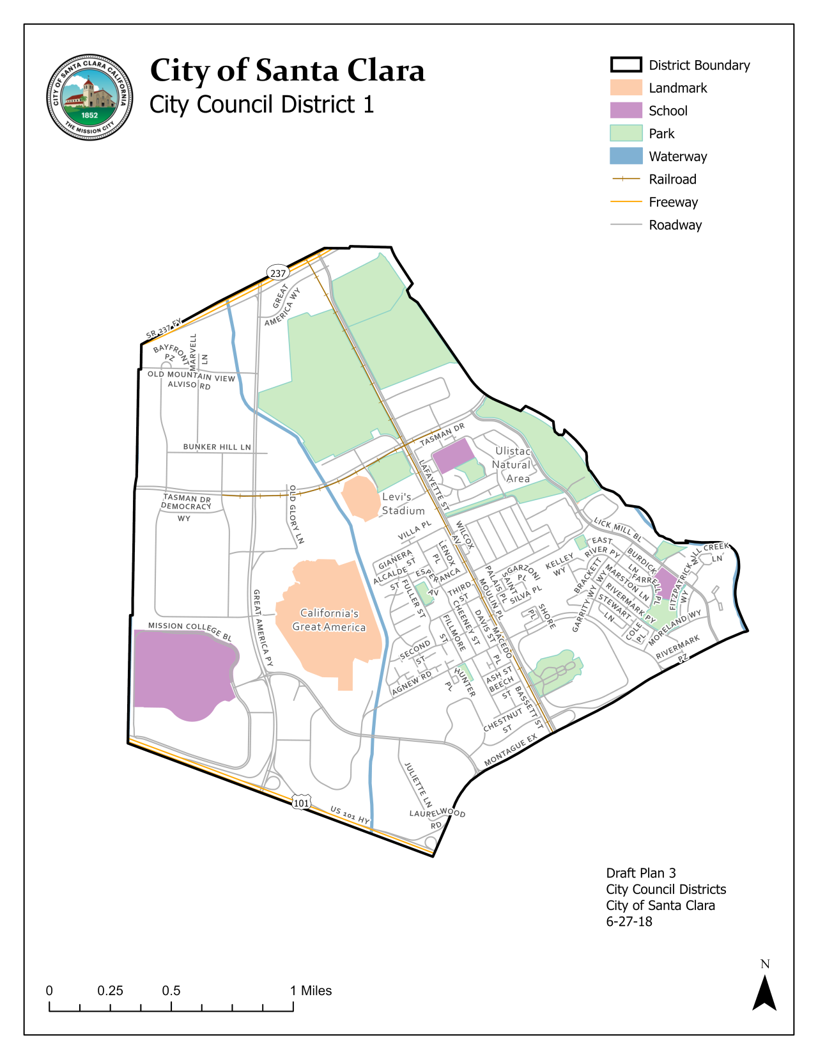
Current
Council District 1

Slide 28
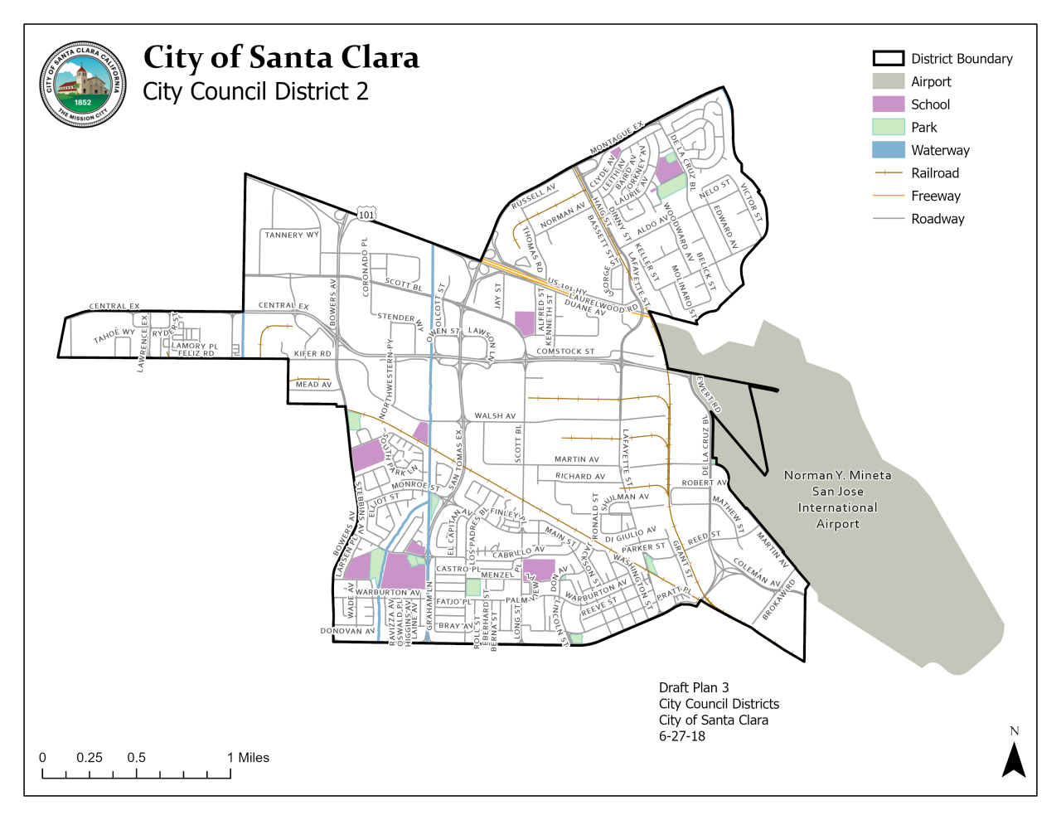
Current
Council District 2

Slide 29
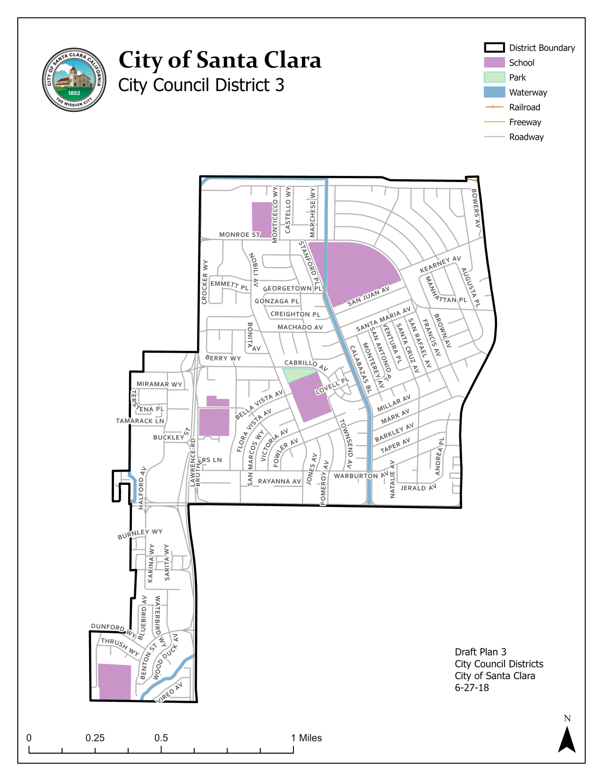
Current
Council District 3

Slide 30
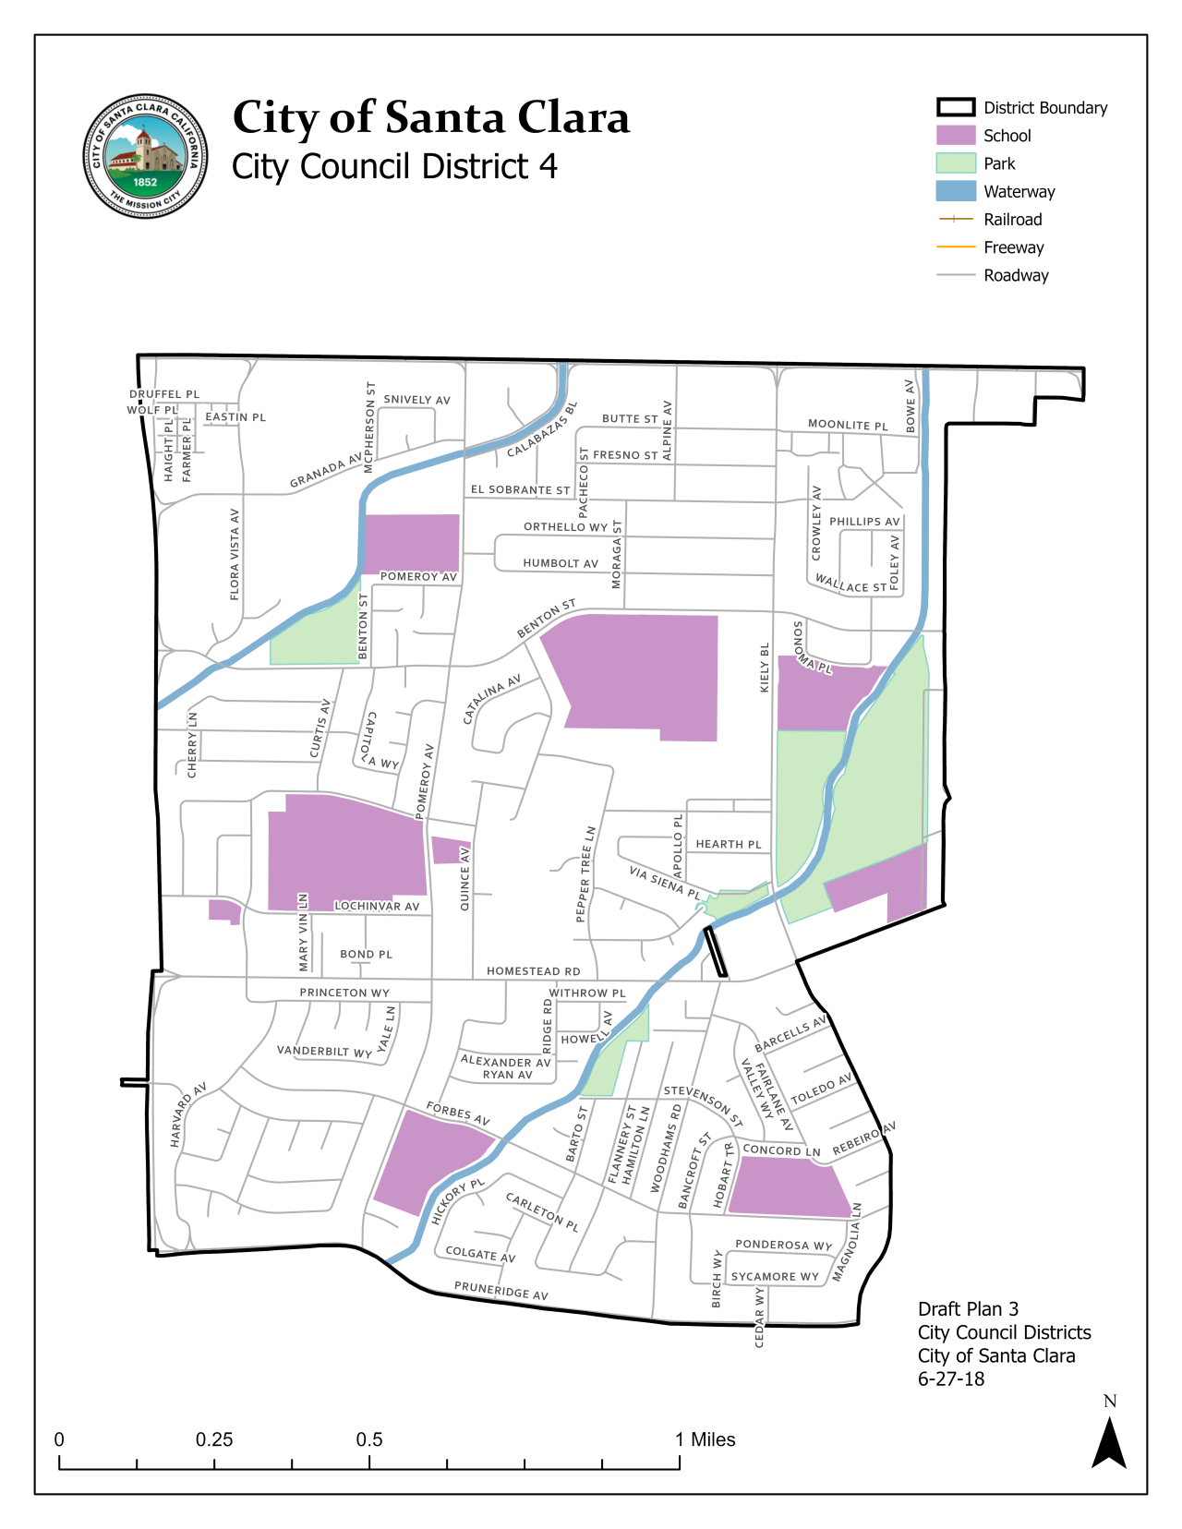
Current
Council District 4

Slide 31
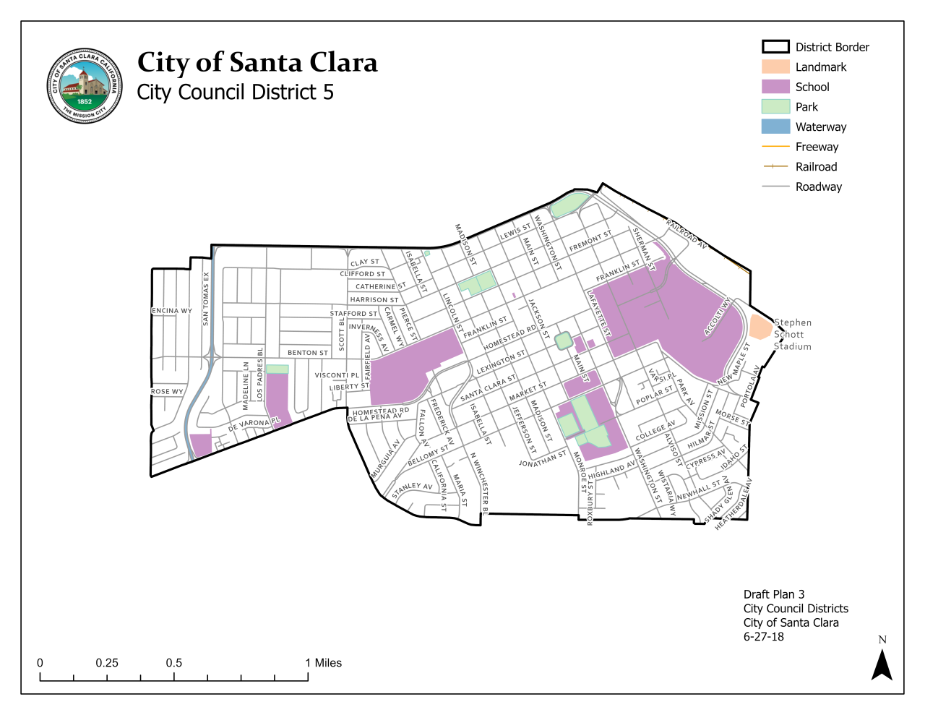
Current
Council District 5

Slide 32
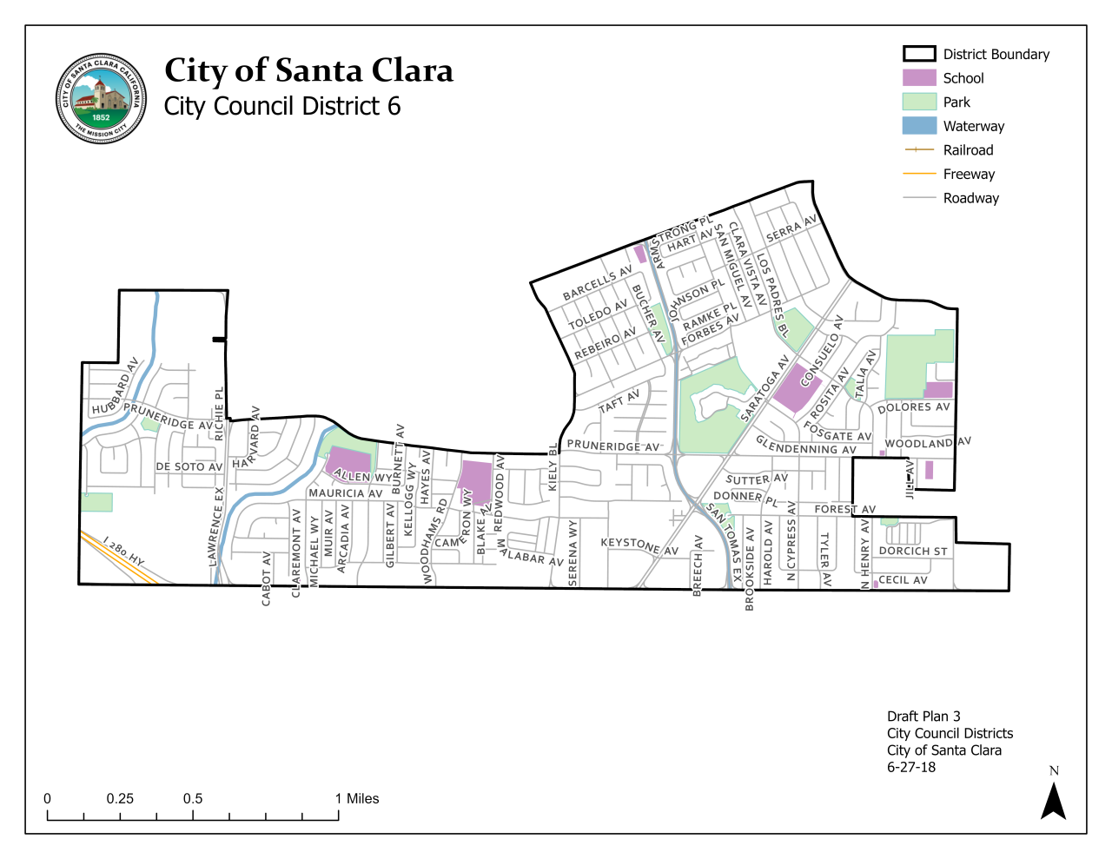
Current
Council District 6

Slide 33
#1 Priority: Population Equality
Council Districts need to be fairly equal in population (some leeway is permitted)
Ideal district size = 1/6 of the 2020 Census population
  City of Santa Clara=127,853 total population; 1/6=21,309 is ideal district population
Plan deviation = Difference between the least and most populous districts, divided by the ideal district population
  10% deviation is permitted = 2,131 persons (21,309 x 10%)

Slide 34
“Packing” and “Cracking” are prohibited
Packing
The Federal Voting Rights Act
District 4
District 1
Minority Voters
Minority Voters
:
“‘Packing’ refers to the practice of filling a district with a supermajority of a given group or party. ‘Cracking’ involves the splitting of a group or party among several districts to deny that group or party a majority in any of those districts.”
-Vieth v. Jubelirer,
541 U.S. 267, 286 n.7 (2004)
District 3
District 2
Cracking
District 1
Minority Voters
Minority Voters
District 4
District 2
District 3

Slide 35
Best Practice: Each orange block representing minority voters is kept intact and in a separate District.
The Voting Rights Act
Minority Voters
Minority Voters

Slide 36
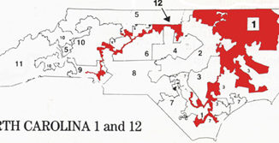
Racial Gerrymandering is not Permitted:
North Carolina’s proposed Congressional Districts after Census 1990
The U.S. Supreme Court found District 12 unconstitutional in Shaw v. Reno, 1993

Slide 37
California Elections Code Section 21621(a):
“Following each federal decennial census, and using that census as a basis, the council shall, by ordinance or resolution, adopt boundaries for all of the council districts of the city so that the council districts shall be substantially equal in population as required by the United States Constitution”

Slide 38
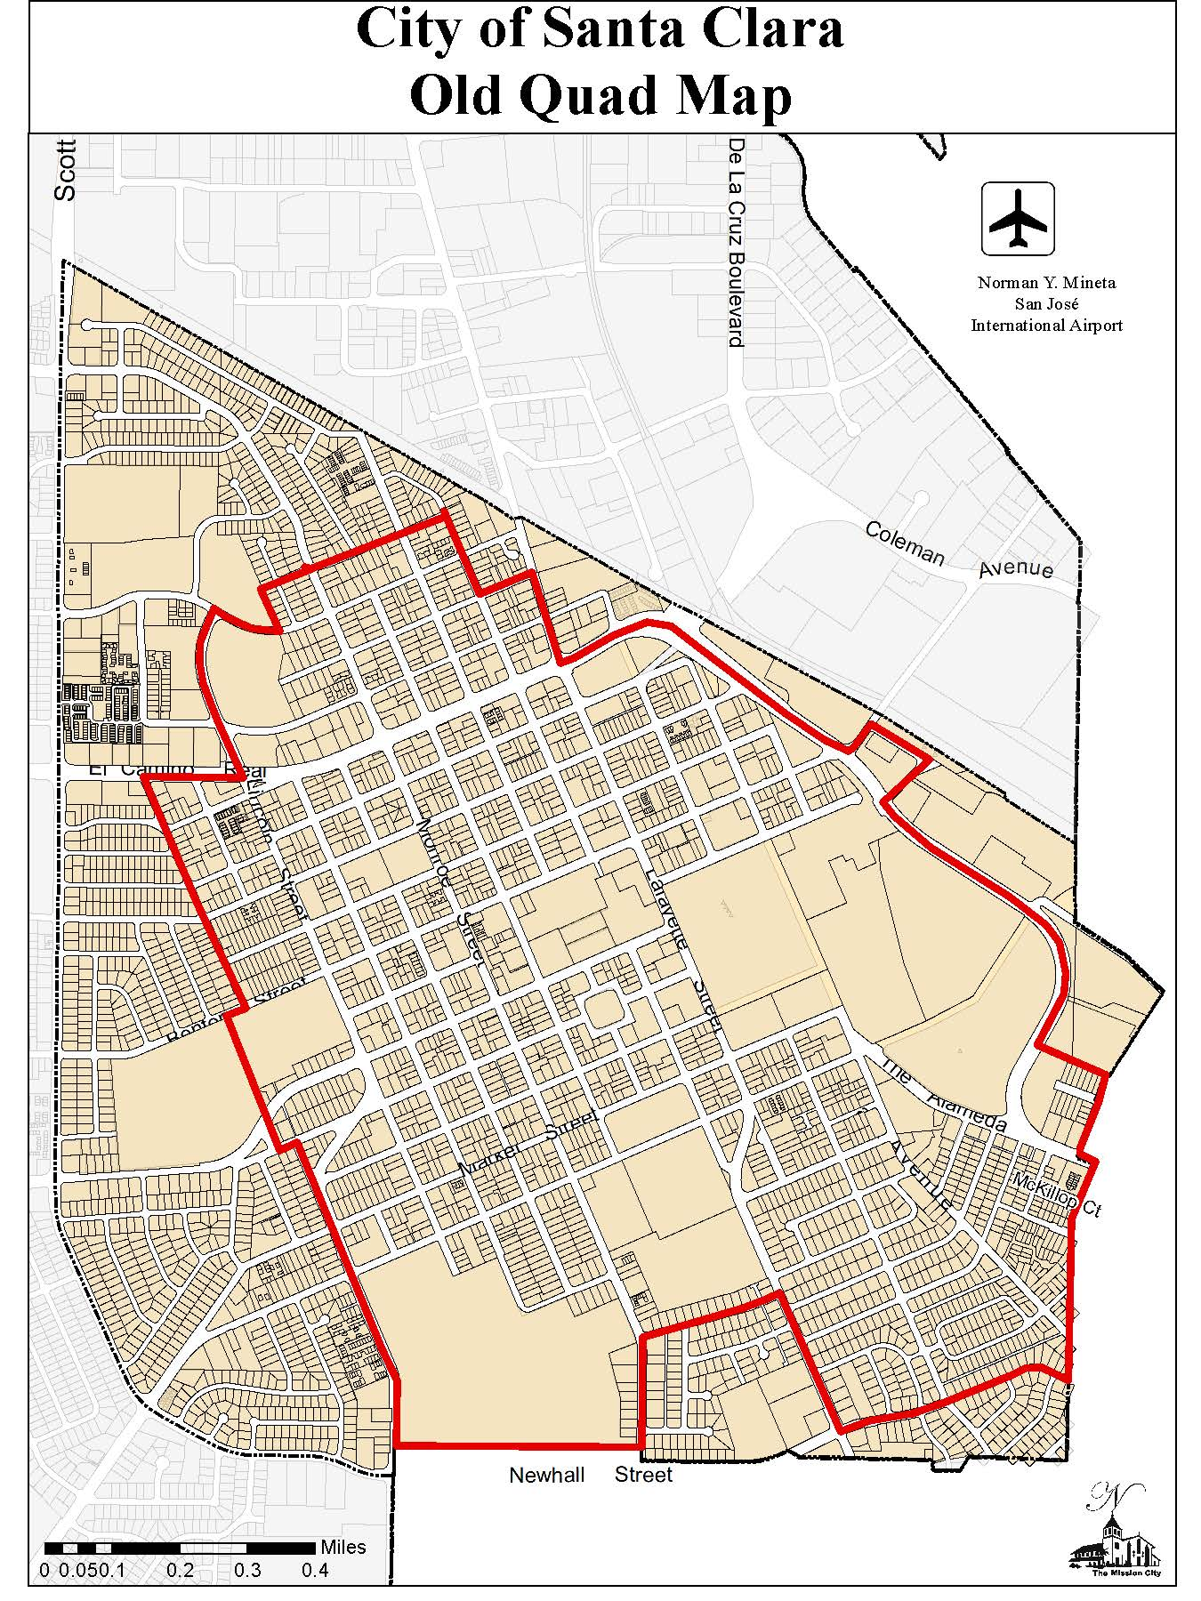
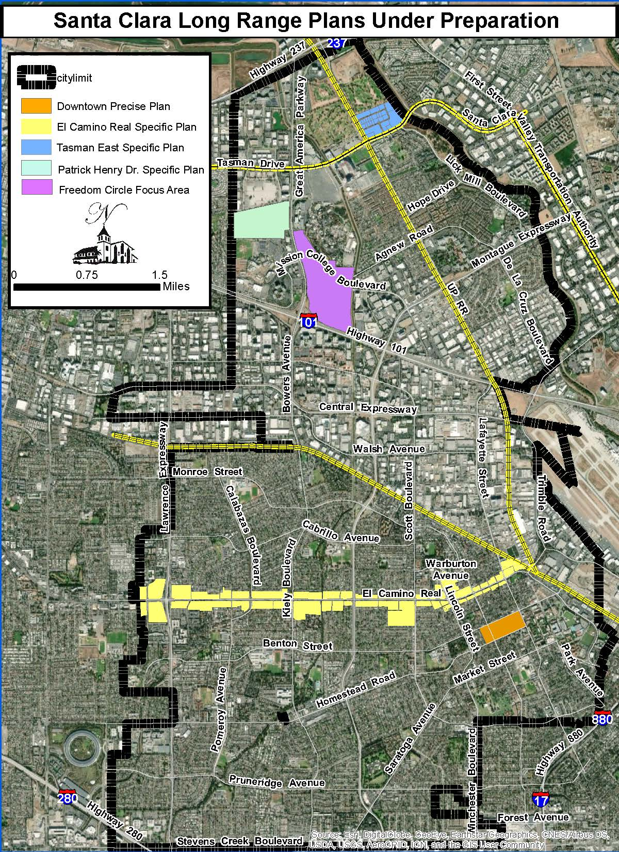
Possible COIS

