Slide 1
Welcome to the City of Santa Clara
Homelessness Taskforce,
Meeting #2!
We appreciate your patience as we set up, and will be starting the meeting shortly.

Slide 2
City of Santa Clara
Homelessness Taskforce
Meeting #2
Thursday May 26th, 2022 6:00 – 8:00pm

Slide 3
Agenda for Today
Welcome, Introductions, Goals
Types of Homelessness Programs &Services
Explore types of programs and services
Discuss programs and services
Community Engagement
Introduce the proposed process
Discuss approach to community engagement
Wrap-Up and Next Steps

Slide 4
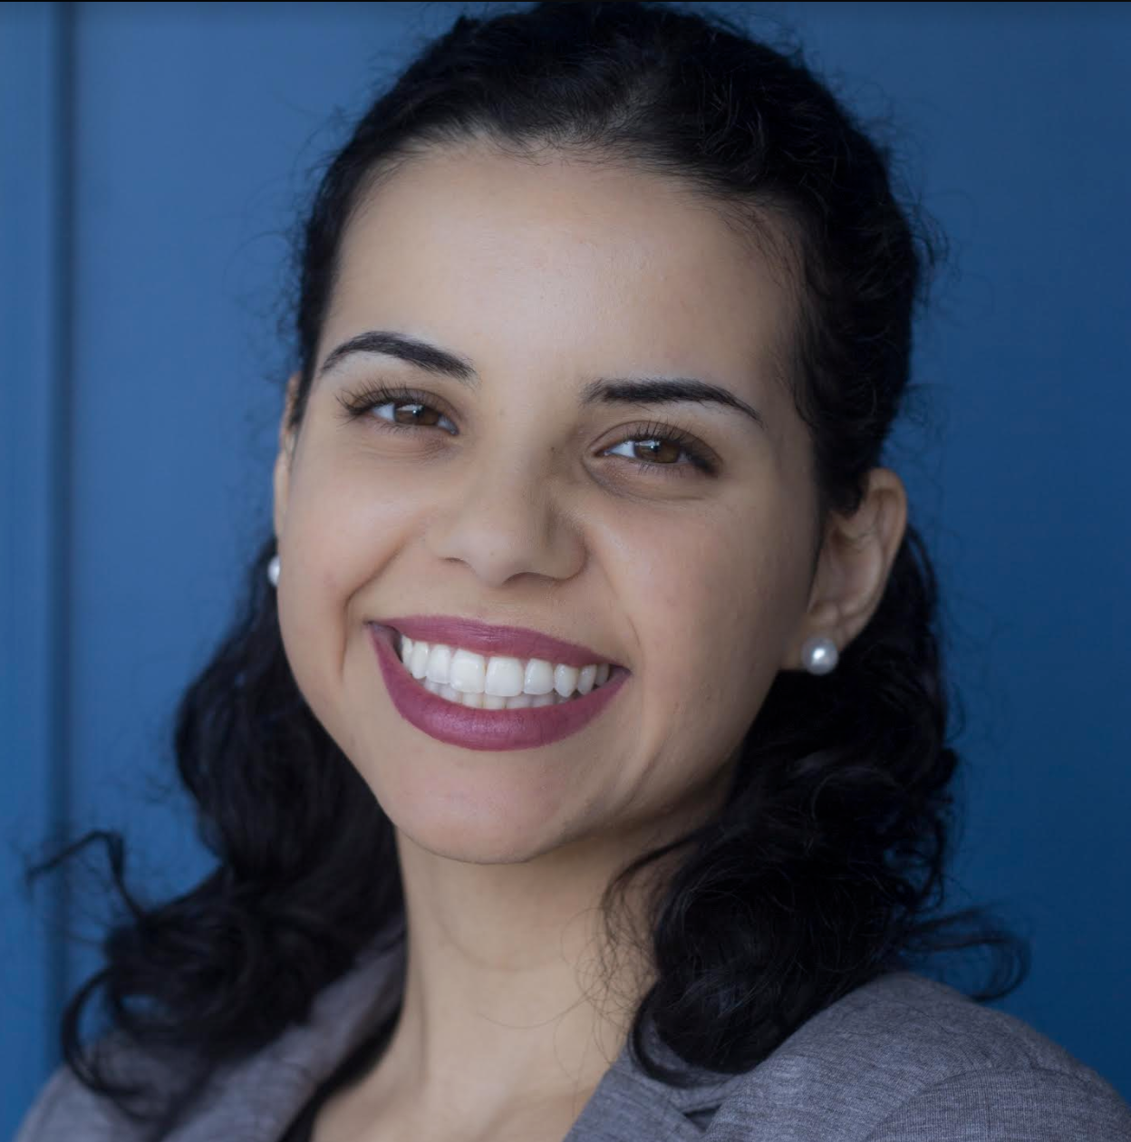
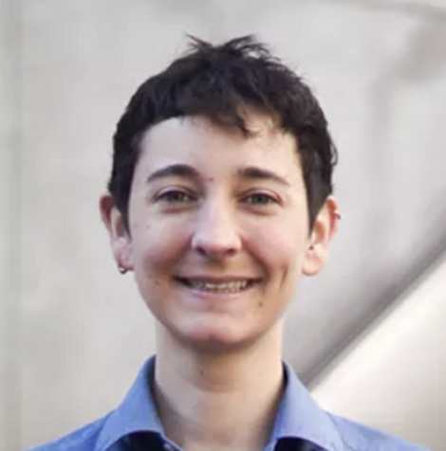
Homebase Team
Carla Carvalho, Policy Analyst II
Eli Hamilton, Directing Attorney
Joy Balinbin, Policy Analyst

Slide 5
City Team
Andrew Crabtree, Director, Community Development Department
Adam Marcus, Housing and Community Services Division Manager
Sgt. Gregory Deger, City of Santa Clara Police Department
Jennifer Caravalho, Staff Aide, Housing and Community Services Division

Slide 6
Taskforce Members
Hilary Barroga County Office of Supportive Housing
Ray Bramson Destination: HOME
Vivian Wan Abode Services
Lori Garmany
Council District 1
VaNae N. Hamilton, Ph.D
Council District 2
Dontae Lartigue
Council District 3
Daniel Huynh
Council District 4
Michelle Ortega Community Member At-Large
Anne McMahon
Council District 5
Catherine Pham|
Council District 6
Santiago Arrendondo Jr. Community Member At-Large
Sparky Harlan Bill Wilson Center
Andrea Urton Homefirst

Slide 7
Zoom Norms for Taskforce Members
We love to see your faces! If possible, please turn on your video.
Have a question?
Please raise your hand using the Zoom function at the bottom of your screen, or use the Chat.
We will be recording this session.
Need help with zoom?
Send a chat to one of the Homebase team or email cityofsantaclara@homebaseccc.org
Notes:
Hi all, I’ll be taking us through some intro slides starting with Zoom norms for taskforce members.
We’d love to see your faces! If possible, please turn on your cameras so we can see who all is here with us today.
If you have a question, please use the raise your hand function at the bottom of your screen before coming off mute, or use the chat function.
As a reminder, this taskforce session will be recorded and later posted on the City’s homelessness taskforce webpage.
If you’re experiencing any issues with zoom, please feel free to send a chat to myself, Carla, or eli or contact cityofsantaclara@homebaseccc.org

Slide 8
Zoom Norms for Attendees
Have a question?
Please use the Q&A function to submit a question to the facilitators.
Need help with zoom?
Send a question to the Q&A or email the Homebase team at cityofsantaclara@homebaseccc.org
We will be moderating Q&A
We may not be able to answer every question, but questions will be saved and reviewed for themes & areas of focus.
We will be recording this session.
Notes:
Next, we’ve laid out zoom norms for attendees.
Please use the Q&A function to submit a question to the facilitators.
As a reminder, the q&a’s will be moderated. Questions from the public will be received and answered as time allows. We may not be able to answer every question within the time limits of this meeting, but we will be saving the questions and reviewing them for themes/ different focus areas.
Once again, this taskforce session will be recorded and later posted on the City’s homelessness taskforce webpage.
And if you’re experiencing Zoom issues, please feel free to chat one of the Homebase team directly or email our team at cityofsantaclara@homebaseccc.org

Slide 9
Discussion Guidelines & Norms
Be as present as you can / attempt to manage distractions
Respect when others are speaking. All perspectives are valued.
Speak from your own (personal, professional) experience.
Listen to understand
Step up, step back
Please engage! Ask questions, respond to others, etc.
Respect others’ thoughts and feelings even when they differ from my own
Other norms?
Notes:
We’ve provided a starting place for discussion guidelines and norms (run through them)
Taskforce members: are there any more guidelines or norms that we should prioritize on this list?

Slide 10
Goals of Today’s Meeting
Review homelessness programs and services
Build our community engagement strategy
Hold space for discussion and input from Taskforce Members

Slide 11
Types of Homelessness Programs and Services

Slide 12
Definitions!
Rental Assistance
Help to set goals and make a plan
Referrals to services & resources
Permanent Housing
A place the person could stay with no time limit
Usually the person has a lease or sublease
Supportive Services
Resources, programs, and services like medical care, behavioral health services, job training, public benefits, child care, etc
Financial help paying rent in a room, apartment, or house
Case Management
Notes:
We'll be using these terms to talk about some of the programs and services we go over. A lot of effective approaches to addressing homelessness or housing instability include these pieces.

Slide 13
Homelessness Prevention
Who is it for? | People who are housed and at risk of losing their housing
What is it? | - Help paying rent or other bills - Case management - Referral to legal services, job training, etc
XXX households connected to the City of Santa Clara
XX% of households housed at the end of the services
$XXXX average cost per household served
Notes:
Adam
Prevention services are focused on people who are currently in housing, but they're about to lose it if they don't have some support. THat support can be financial, like help covering rent or paying emergency costs. Case management is also an important part of prevention – people who are in crisis and about to lose they're housing can benefit from someone to help them identify options and make a plan. Supports like legal services, job training, and other resources can also help people stay housed.
There's a Countywide Homelessness Prevention System that provides these supports, which is available to City of Santa Clara residents.

Slide 14
Street Outreach
Who is it for? | People who are living outside or in vehicles
What is it? | - Engage and build relationships - Coordinated Entry assessment - Basic hygiene, food, and safety needs
XXX households connected to the City of Santa Clara
XX% of households housed at the end of the services
$XXXX average cost per household served
Notes:
Sgt Deger
Street outreach can be: teams of people going out to encampments or other places people are with resources, information, food, and other resources. Outreach can also be mobile showers, toilets, and laundry; medical or behavioral health workers. One key strategy for effective outreach is to include people with lived experience being unhoused in outreach efforts, to help build trust and open communication.

Slide 15
Emergency Shelter/Temporary Housing
Who is it for? | People who are experiencing homelessness
What is it? | - A safe place to sleep inside - Coordinated Entry assessment - Basic hygiene, food, and safety needs - Supportive services, varies by shelter
XXX households connected to the City of Santa Clara
XX% of households housed at the end of the services
$XXXX average cost per household served
Notes:
Emergency Shelter is a temporary place to sleep. In this County, the terms emergency shelter and temporary housing are often used together, to mean a whole range of short-term options that give someone a safe place to sleep, often while waiting for a referral to a housing program or while looking for housing. Shelter and temporary housing programs look a lot of different ways – large "congregate" shelters where there are large rooms full of cots or beds, they can be in hotels or converted hotels (this model was expanded a lot during COVID), there are several tiny home shelters within the County, and sometimes safe parking programs are included in the range of "shelter" options, because they provide a safer place for people to park.
Shelter and temporary housing and just that – temporary. These are not considered permanent housing, so people in shelter are still considered to be experiencin homelessness.

Slide 16
Transitional Housing
Who is it for? | People who are experiencing homelessness and need medium-length support (1-2 years)
What is it? | - A limited time stay in a room or apartment the project owns or leases - Case management - Supportive services focused on income & stability
XXX households connected to the City of Santa Clara
XX% of households housed at the end of the services
$XXXX average cost per household served
Notes:
Transitional Housing programs are a very traditional type of housing support, and there are pros and cons to TH. TH programs can look really different, but a typical model is that a service provider owns or rents a house or a building, the participants in the program will live in that house or building, often multiple people at one site, and the program provides case management and services while the participants are living there.
At the end of Transitional Housing, the participants will have to move out of that housing, so TH isn't permanent housing. But the goal of TH is to help people increase their stability and increase their income so that they can find their own place to live when they leave.
Because Transitional Housing always has a time limit – usually not longer than 24 months – it's best for people who need some substantial support, but could increase their income and stability and eventually be able to maintain housing independently.

Slide 17
Rapid Rehousing
Who is it for? | People who are experiencing homelessness and need medium-length support (1-2 years)
What is it? | - Rental assistance in permanent housing, decreases over time - Case management - Supportive services focused on income & stability
XXX households connected to the City of Santa Clara
XX% of households housed at the end of the services
$XXXX average cost per household served
Notes:
Rapid rehousing is another type of program that works best for people who need some substantial support, but who can work with the program to be afford housing on their own within a year or two.
Like Transitional Housing, Rapid Rehousing provides case management and services usually no longer than 2 years. The difference is that, in RRH, the participants aren't living in housing that the program owns, and they usually aren't all living in one location. Instead, the program helps a participant find a room or apartment in the community from the very beginning of the program, and then they offer rental assistance to help the person afford their rent. As time goes on and the participant works with the program to increase their stability and income, that rental assistnace can get lower and lower, until the participant exits the program.
So in Rapid Rehousing, the very first step is to help someone find permanent housing, and then there's a lot of support to help them stay in that housing.

Slide 18
Permanent Supportive Housing
Who is it for? | People with disabilities who need long-term or permanent support
What is it? | - Rental Assistance in permanent housing OR permanent housing the project owns or leases - Case management - Supportive services focused on health, wellness, and quality of life
XXX households connected to the City of Santa Clara
XX% of households housed at the end of the services
$XXXX average cost per household served
Notes:
The final type of program we'll talk about today is Permanent Supportive Housing. PSH is specifically for people experiencing homelessness who have a disabling condition that is likely to keep them from staying housed without long-term support. This resource is targeted to people who have the most challenging barriers to housing stability – complex behavioral health needs, physical disabilities, and/or other chronic health conditions. PSH combines permanent housing with long-term case management and services that are focused on addressed the participants health needs, as well as supporting their independence and quality of life.
PSH is the most effective type of resource for people who have the highest barriers to housing stability. PSH programs in Santa CLara COunty, and across the country, consistently show high levels of retention – people staying in housing for years – for populations that have experienced homelessness for the longest and have the most severe vulnerability.

Slide 19
Discussion Questions!
What questions do you have about these types of programs?
Which programs or services have you seen or experienced in your community, and what did you think about them?
What do you see as the most needed programs or services in the City of Santa Clara?
Which types of programs are you interested in hearing more about and discussing at a future Taskforce meeting?

Slide 20
Community Engagement

Slide 21
The Goal
To leverage the expertise of key stakeholders identified by the Taskforce and the City to identify priorities and develop recommendations to reduce homelessness and its impact.
What are the local needs and resources in the City of Santa Clara?
Notes:
In our experience working in other communities, we’ve found that engaging a wide range of stakeholders in the planning process and providing meaningful and intentional opportunities for input and feedback from community members is important for a successful plan and future implementation.
Allows different individuals and groups to talk about the needs and resources in the communities, so the plan that is created is unique to the City of Santa Clara and what’s going on here.

Slide 22
Collecting Feedback and Information
Community Kick-Off Event
Open & virtual meeting, opportunity for any community member interested in contributing to the planning process
Stakeholder Interviews
Individual interviews with 3-4 key stakeholders to provide in-depth information
Focus Groups
3-4 meetings with key stakeholders, with structure developed in partnership with City staff and Taskforce members
Stakeholder/ Provider Surveys
E-surveys distributed widely throughout the community so stakeholders can provide feedback on how to address homelessness in the area
Notes:
There are several ways we will engage the community. The community kick-off event is an open (and most likely virtual) event that would engage any community member that is interested in contributing to the planning process, including home owners, renters, business owners, housing and service providers, representatives of schools, law enforcement, healthcare providers, business and community leaders, unhoused residents and others with lived experience of homelessness.

Slide 23
Stakeholders
Housing and service providers
Business and community leaders
Neighborhood associations
Healthcare/ behavioral health providers
Representatives from schools
City departments
People with lived experience
Community members at-large

Slide 24
Community Members At Large
Community Kickoff Event
Taskforce Meetings
Email public comments to cityofsantaclara@homebaseccc.org
Stakeholder Survey

Slide 25
Who do you think should be a part of the community engagement process?
Notes:
Jamboard: https://jamboard.google.com/d/1ZUssLIieQYb_hVWlMoQ2Obo2hWZ_9ukxeDVD0P7St4w/viewer?f=1

Slide 26
What do you want to know from these community members and groups?

Slide 27
Wrap Up & Next Steps

Slide 28
Taskforce Timeline
June - August 2022
Gather and synthesize community input
September 2022
Homebase and City draft plan
May 2022
Identify priorities and areas of focus
Plan for community engagement
Identify and refine goals and objectives for draft plan

Slide 29
Closing
Next meeting: Thursday June 23rd 6:00 - 8:00pm
Topics for discussion:
Update on community engagement and discussion of emerging themes.
Coordinate outreach and taskforce involvement in continued community engagement.

